Slide 1


Slide 2







user
user
user
50k
100k
1million

Slide 3
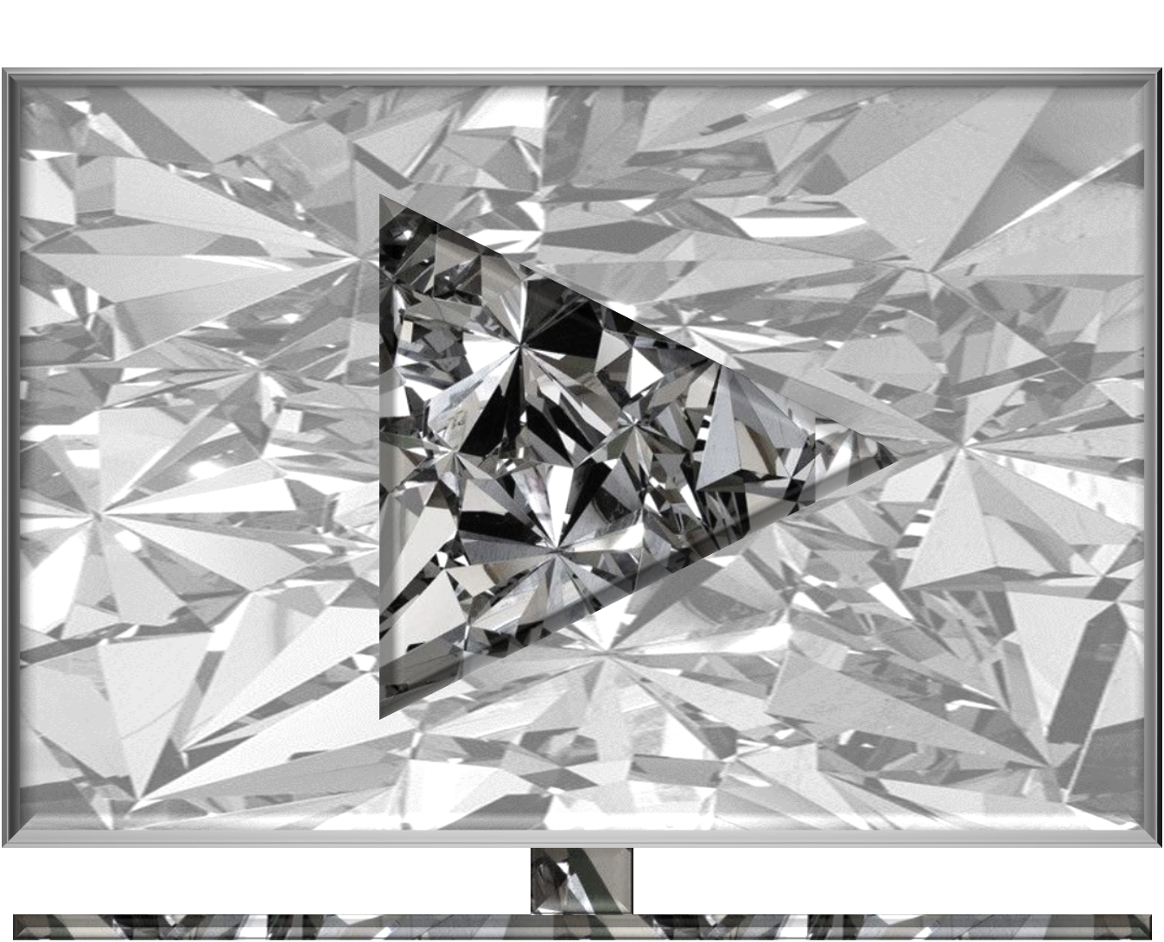





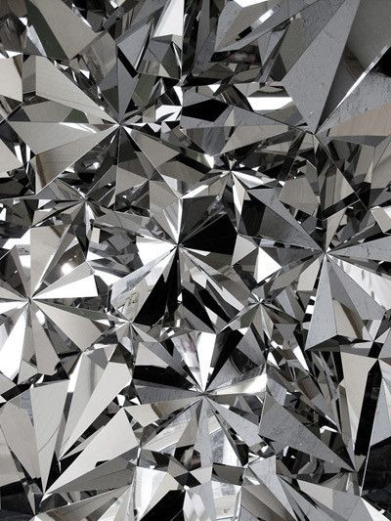


user
user
user
10m
50m
100m

Slide 4
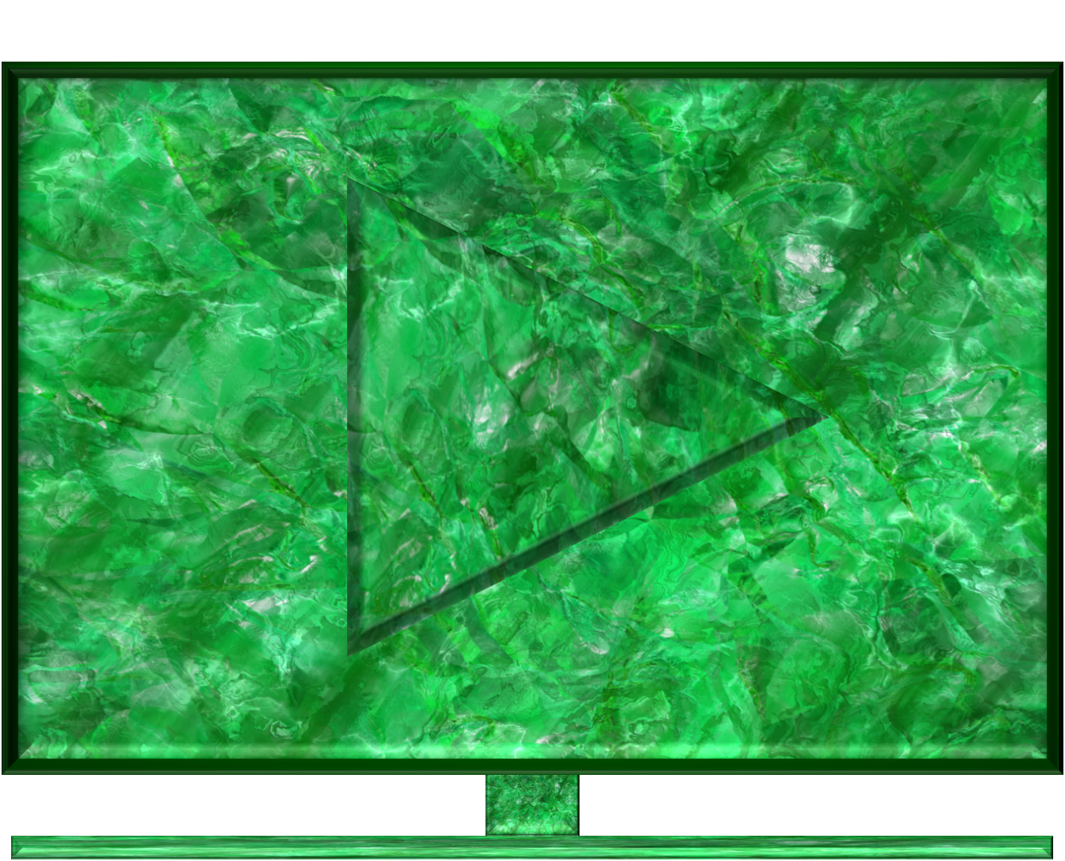

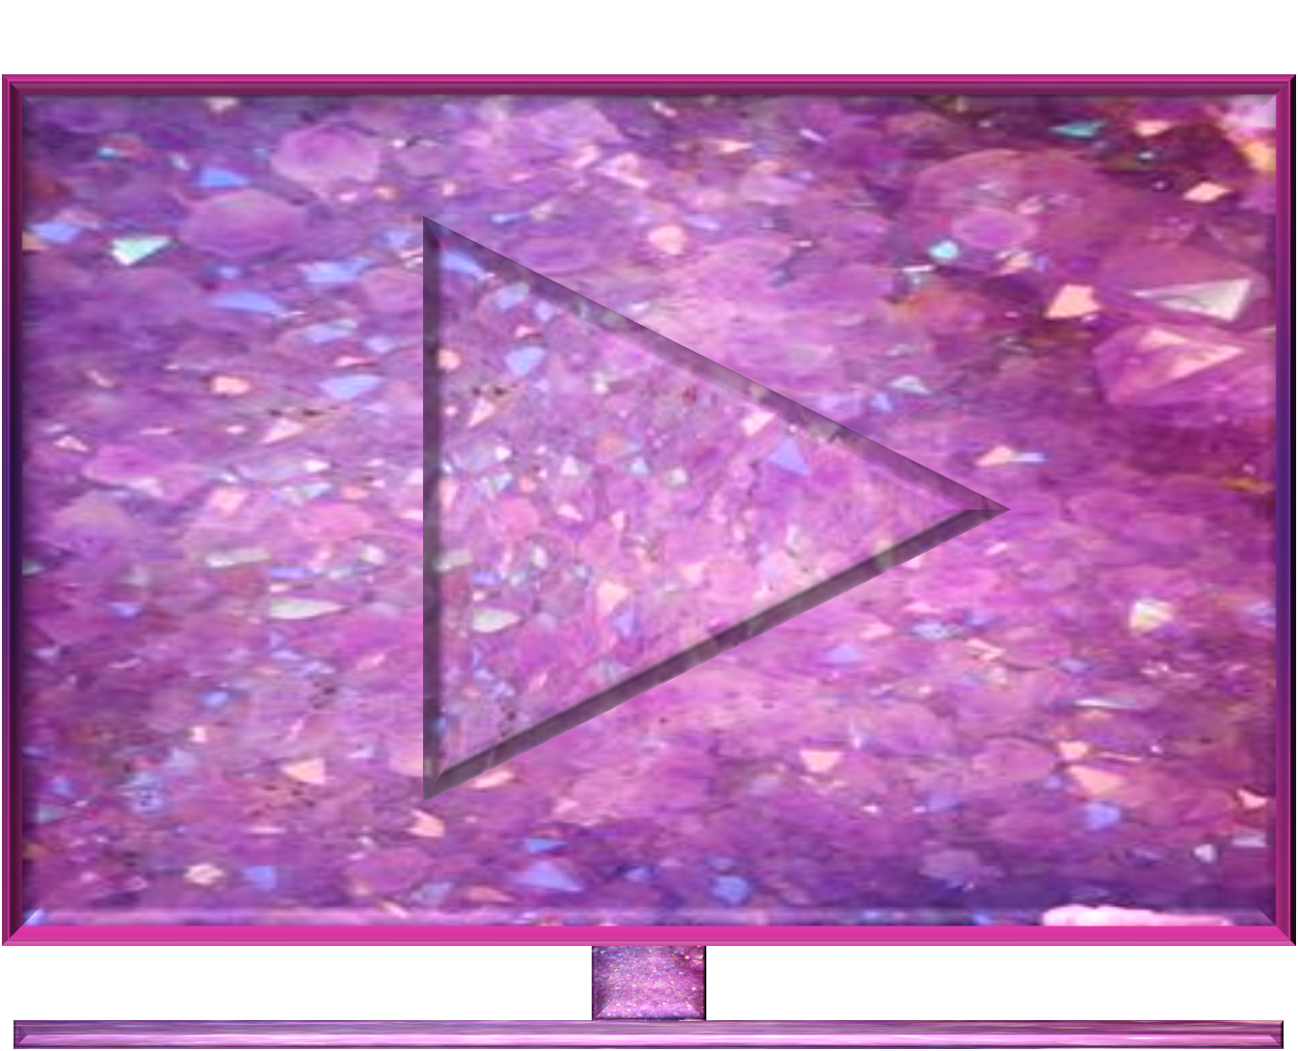






user
user
user
500m
1billion
2billion

